Slide 1
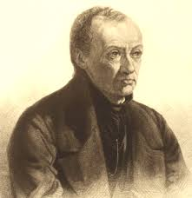
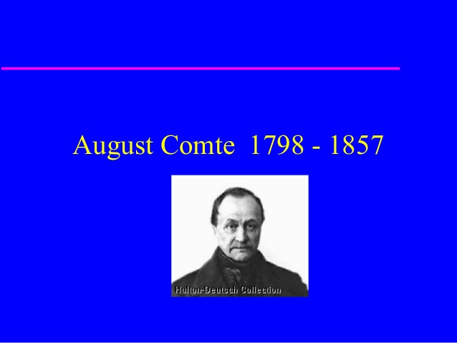

Slide 2
Brief Background
  Born on January 19, 1798 in Montpellier, France.
  Very early in his school career he lost the faith of his parents (monarchism and Catholicism).
  Substituted for republican faith in liberty. The only teacher who made a very strong impression on the young Comte was his professor of mathematics, Daniel Encontre.
  Socially, Comte was disturbed by the destructive effects of the French revolution and the Industrial revolution.
  He wanted to contribute his quota to restoring order through the development of a theoretical science of society.

Slide 3
The Work: Sociology as Science
He first called it SOCIAL PHYSICS
Later replaced with Sociology because of a Belgian social statistician, Adolphe Quetelet, who ‘stole’ the term from him (Comte).
Sociology: a hybrid term comprising Latin and Greek expressions.
Socius: Latin term meaning friend, companion or associate.
Logos or ology: the study of, doctrine, discourse or theory.
Thus, socius + logos = sociology, literally means the study of companionship or groups of human beings (Rawat, 2009).

Slide 4
The Subject Matter
Sociology shares affinity with biology; hence society is a social organism.
Biology decomposes the living organism: cells, tissues, and organs
Sociology decomposes society into: families, castes, social institutions
Comte refuses to see individuals as elementary parts of society. The scientific spirit forbids that.
The true social unit is the family reducible to the elementary couple.
Families become tribes, tribes become nations.

Slide 5
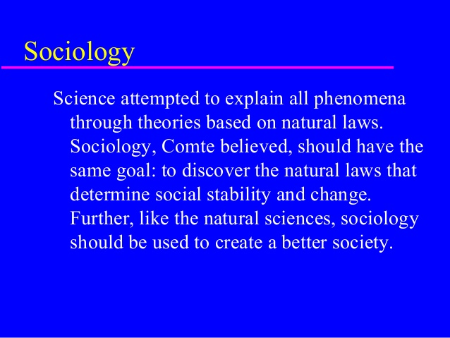
The Subject Matter Cont’d

Slide 6
The Subject Matter Cont’d
Thus the sociologist should be interested in analyzing the causes of stability and change in society. In other words, social statics and social dynamics.
Social statics: Social processes or aspects of social life which bring about order, peace and harmony in society. E.g. language, family, religion, division of labour, etc.
social dynamics: Social processes or aspects of social life which bring about social change or progress in society. E.g. technology, cultural diffusion, war, science, etc.

Slide 7
Preferred Methods of Inquiry (Methodology)
The methodology of Sociology is the same as it is for the Natural Sciences:
  Observation
  Experimentation
  comparison

Slide 8
Methodology Cont’d
Observation: Means the direct observation of the human behaviour, guided by a preliminary theory of what you expect to observe, i.e. some hypotheses.
Experimentation: Direct experimentation not possible in sociology. But variation in circumstances or situation of people just to see their reaction.
and Comparison: human with animal societies gives clues to the first germs of the social relations and to the borderlines between the human and the animal.

Slide 9
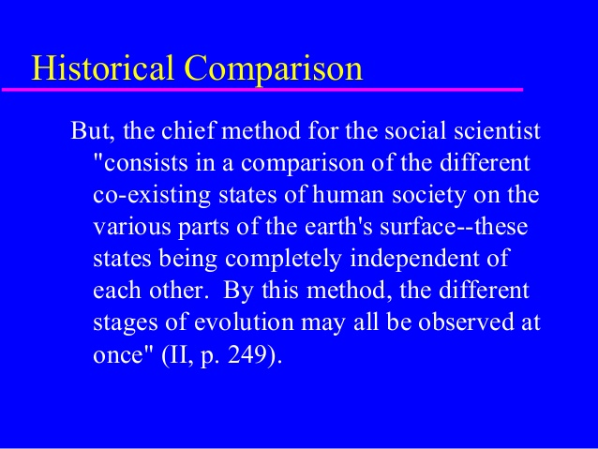
Methodology Cont’d

Slide 10
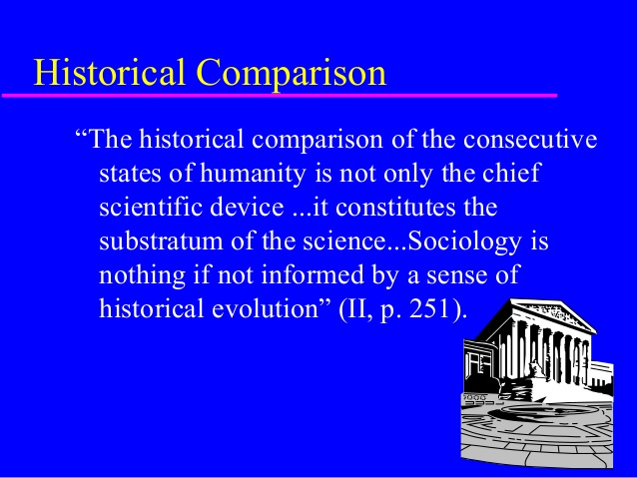
Methodology Cont’d

Slide 11
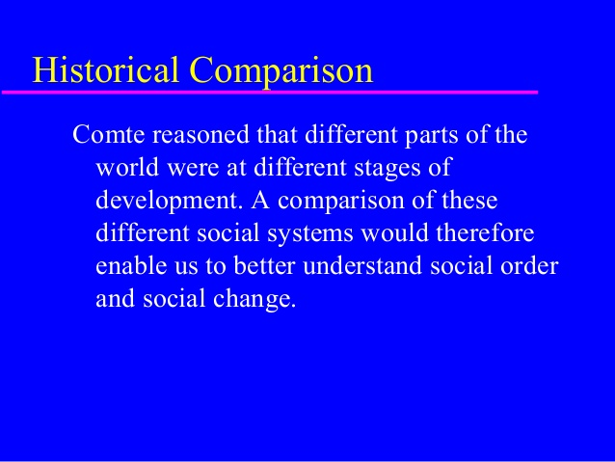
Methodology Cont’d

Slide 12
The Law of Three Stages
Comte emerged with this central conception, The Law of Human Progress, to explain the development of human groups or the entire human race.
He retraces this law in ontogeny, the development of the individual human organism.
A devout believer in childhood, doubt and experiment at adolescence and a natural philosopher in adulthood. Mankind in its growth has traversed these three major stages in succession.
In the same vein, every society evolves in three stages successively.

Slide 13
The Theological Stage:
The human mind, seeking the essential nature of beings, the first and final causes (the origin and purpose) of all phenomena; attributes causes to the action of supernatural beings (religion).
Comte subdivides this stage into three sub-stages
Fetishism: Worship of objects such as trees, stones, rivers, mountains.
Polytheism: Belief in many gods at the same time.
Monotheism: Belief in single divinity – islam, xnity, etc.
All phenomena – social, physical, health, economic, political; is explained from the point of view of the supernatural or religion.

Slide 14
The Metaphysical Stage:
The mind supposes abstract forces, veritable entities (that is, personified abstractions) capable of producing all phenomena.
Explanations of social occurrences are sought from
Fate: Programmed, predetermined, unalterable, right from the source.
Luck: Good fortune
Chance: Probability, could be good or bad.
and Destiny: May be changed
There is doubt and disbelief in the supernatural.
For instance, when one dies, it is explained that it is natural to die once you are born. Or death is our fate and not a supernatural event.

Slide 15
The Positivistic Stage:
The mind has given over the vain search after Absolute notions, the origin and destination of the universe, and the causes of phenomena, and applies itself to the study of their laws.
Scientific methods of enquiry are applied to unravel the causes of events and their explanations. At this stage, traditional religion becomes irrelevant as source of explanation of social phenomena.
Scientific laws and explanations developed by human wisdom become the order of the day.
Comte argues that not only would science (sociology) solve social problems, it would have the capacity to predict future occurrences and prescribe preventive methods.
Thus, sociologists would form a Royal Priesthood of Humanity and take positions in the economy, politics, health, etc. to serve people.

Slide 16
The Scientific Stages
Scientific knowledge also passes through stages similar to societies. Each stage building on the knowledgebase of its predecessor. Different sciences evolve at different rates. First there was astronomy, then physics, chemistry, biology, and finally sociology.

Slide 17
The Scientific Stages
Each science in the series is based on the prior development of the once preceding it; each is more complex than the last.
The social sciences are the most complex of all and the highest in the hierarchy.
Sociology offers the completion of the positive method. All other are preparatory to it.

Slide 18
The Scientific Stages
According to him, sociology shares an affinity with biology in the sense that whereas biology studies the physical human body, the sociology studies the social body formed by society.
However, sociology is more complex because its subject matter, man, is very dynamic. Hence, sociology should be seen as the Queen of the sciences in the hierarchy:

Slide 19
The Hierarchy of the Sciences.
Sociology
Biology
Chemistry
Physics
Mechanics
Astronomy
Mathematics
Mathematics, according to Comte, is not a science but rather a tool used by all the scientists.

Slide 20
DISCUSSION
Critically examine the ideas of Comte on society and sociology as a science.

